Slide 1


Survey Chatbot platform enabling big data analytic for Smart Energy

Slide 2

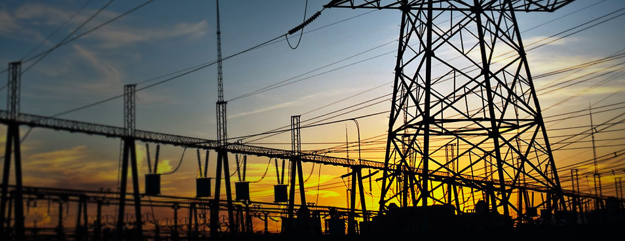
ENGIE Challenge: Micro grids – Data Sharing
Southeast Asia is fragmented market.
Micro grids are answers ,and data is needed.
Utilities can’t gather information form their potential users

Slide 3


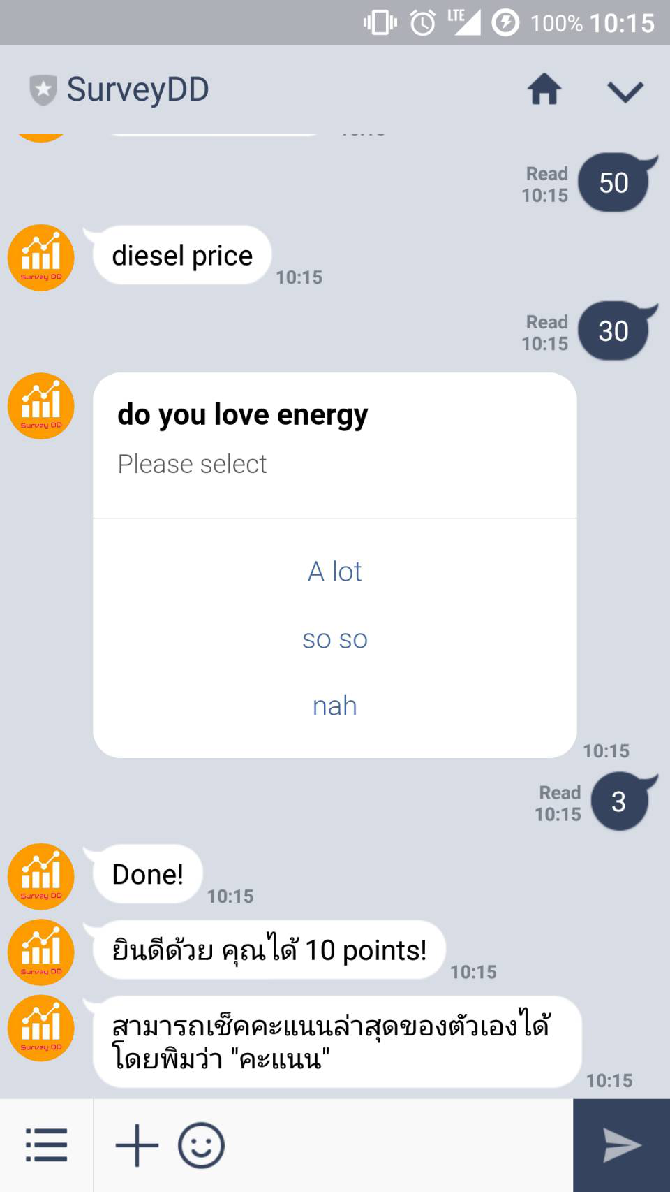


SOLUTION: Survey DD
Is the first Survey Chatbot platform that enable big data analytic for Smart Energy
Is the most user friendly platform with
83% of Thai population on board
Provides targeted survey and incentive system to ensure Reliable Data for big data analytic

Slide 4

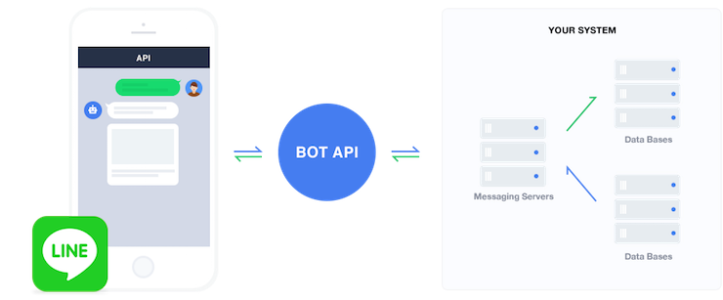









How Survey DD Work?
Add Friend
Partnership
Customers
Survey DD
Utilities
Survey & Contents
Survey & Contents
Answers
-Data Set
-Dash Board
-Analytics
Reward/Point
Utility Bill Discount
Redeem
Convert
Items
Retail Shops

Slide 5




Benefits
Customers
Utilities
Utility Bill Discount (Ranking System)
Insight and reliability data sets
Reward Points and Referral System
Dash Board and Encrypted Database
Useful Contents form Utilities
Communication channel
Best Deal form Smart Energy Venders
Tailor-made survey and analytic for future plan

Slide 6
Demo

Slide 7






TEAM
Satjapong Meeklai (Boss)
Data Specialist
Work: Data Scientist/Engineer, Que Analytics
M.Eng: Que Analytics, Tokyo University of Agriculture and Technology
B.Eng: Computer Science, KMUTT
Tanawat Knouhit (Fact)
Smart Energy Expert
Work: Energy Application Laboratory, PTT
M.Eng: Mechanical Engineering, CU
B.Eng: Mechanical Engineering, KMUTT
Napat Kosolworrawattanakul (Boom)
Smart Energy Expert
Work: Energy Application Laboratory, PTT
M.Eng: Electrical Engineering, CU
B.Eng: Electronic Engineering, KMITL
Suchat Ngamchuenng (Musa)
Product Developer
Work: Southern Regional Head, PTT Digital
M.Sc. Communication Engineering, TGGS, KMUTNB
B.Sc. Technical Education of Electrical Engineering, KMUTNB
Win Mayuraritpibal (Win)
Product Developer
Work: ExpresSo (Innovation Lab), PTT
B.Eng: Automotive Engineering, CU

Slide 8






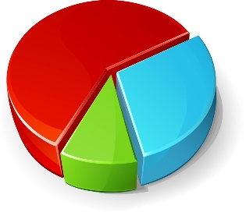
How Survey DD Work?
Utilities
Add
Customer
Survey
Customer
Reward/Point
Customer
Heroku Cloud

Slide 9
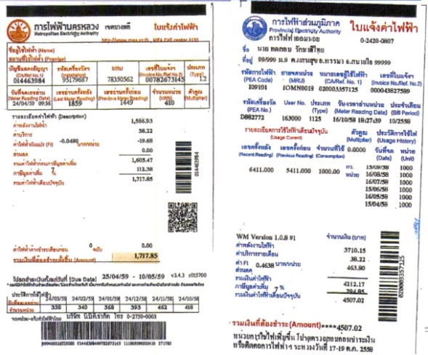

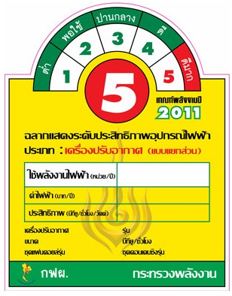

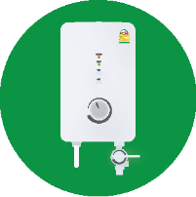

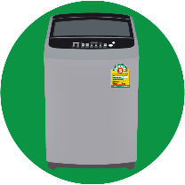
Image Processing
Electric Bill
Location (Address)
Total Energy Consumption (Unit)
Label No.5
Appliance Specification
(Power)

Slide 10
Data from Chat Bot
Data from Analysis
Electric Bill
Total Energy Consumption: xxx.xx units
Appliance Power (Spec.):
Air Conditioner
Refrigerator
Water Heater
Television
Washing Machine
Usage Time / Day of Aircondition
Energy Consumption for Each Appliance
Air Conditioner
Refrigerator
Water Heater
Television
Washing Machine
(Estimated)
Energy Index =
Energy Consumption for Each Appliance/No. People in Household
Air Conditioner
Refrigerator
Water Heater
Television
Washing Machine
Label No.5
Text Answer

Slide 11
Innovative data collection for enhancing future energy
ENGIE Challenge: Micro grids – Data Sharing
User Profile
Type of uses
Demand
Load Profile
Etc.

Slide 12
Problem on particular survey
The potential micro grid-users
On-site survey – Cost, Man-hour
IOT devices
Operator
Time Consuming

Slide 13








Chatbot

Slide 14
System Architecture

